Slide 1
A Predictive Model for Outlet Sales
Recommendations to Big Mart by DCN Consultants

Slide 2
Based upon Big Mart sales history...
We set out to find the most important data in determining specific items’ sales levels.
We also used this data to create a model to predict anticipated sales for new items.
What items sold most frequently, and what are the gross sales of the item per outlet?
Let’s take a look...

Slide 3
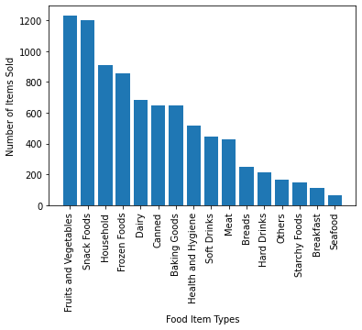
Fruits, Vegetables & Snack Foods
These items were the most common in our dataset provided, and they tend to be inexpensive items.

Slide 4
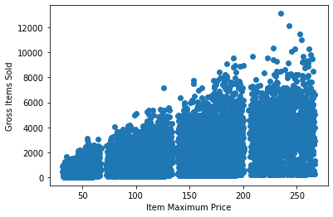
The more expensive the item, the more it sells!
Despite the prevalence of smaller/cheaper items in our model, the data trend shows the higher the number of items sold, the higher the price tends to be.

Slide 5
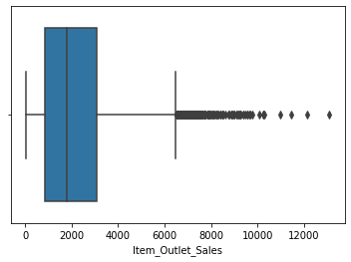
The median item sales per outlet is about 2,000
We can see that there are a handful of items that moved over 6,000 units per outlet.
Most are between approx. 1,000 to 3,000.
Items above 6,000 tend to be the most
expensive ones, based on the last slide.
While those items are outliers, they seem
to drive total revenues up quite nicely.

Slide 6
In Conclusion...
The higher the price of an item, the more it seems to sell.
We can use our model to predict the sales of new items that Big Mart may choose to bring in. Based on limited shelf space, it might sense to stock more expensive items in order to increase not only sale numbers, but total sale revenues as well.

